Slide 1
What is Unity Catalog?
Unity Catalog is a data and AI governance solution built into the Databricks Data Intelligence Platform. It provides centralized access control, auditing, lineage and data discovery capabilities across Databricks workspaces.

Slide 2
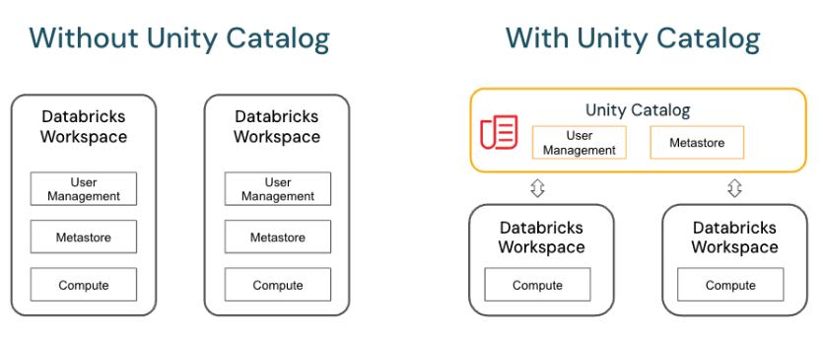
Unity Catalog
Hive metastore
Separation in workspaces
Unity catalog metastore (data discovery, lineage tracking)
Centralized approach for multiple workspaces

Slide 3
Key features of Unity Catalog
Define once, secure everywhere: Unity Catalog offers a single place to administer data access policies that apply across all workspaces.
Standards-compliant security model: Unity Catalog’s security model is based on standard ANSI SQL and allows administrators to grant permissions in their existing data lake using familiar syntax, at the level of catalogs, schemas (also called databases), tables, and views.
Built-in auditing and lineage: Unity Catalog automatically captures user-level audit logs that record access to your data. Unity Catalog also captures lineage data that tracks how data assets are created and used across all languages.
Data discovery: Unity Catalog lets you tag and document data assets, and provides a search interface to help data consumers find data.
System tables (Public Preview): Unity Catalog lets you easily access and query your account’s operational data, including audit logs, billable usage, and lineage.

Slide 4
Administrative Roles in Unity Catalog
Account Admin: Create and link metastores to workspaces, assign the metastore admin role, configure storage credentials, enable sharing etc.
Metastore Admin: Owner of the metastore. The only user who can grant privileges on the metastore itself.
Workspace Admin: Can add users and groups to a workspace, delegate workspace admin roles, manage job ownership, and handle workspace objects.

Slide 5
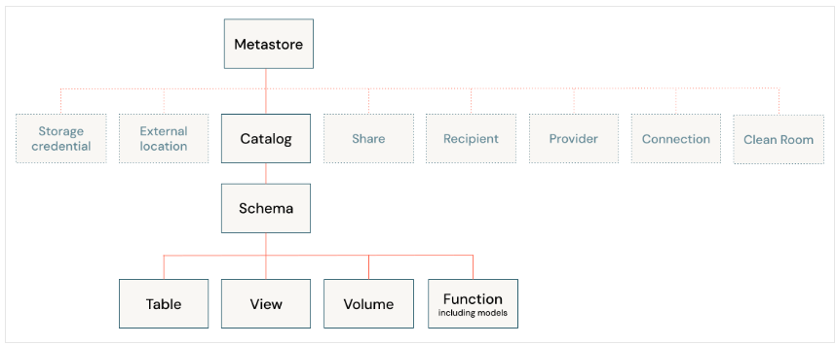
Unity Catalog Object Model

Slide 6
Steps to perfom
Create Premium Azure Databricks
Create ADLS Gen2 storage account and container
Create Access Connector for ADB
Grant Storage blob data contributor to ADB on ADLS Gen2
Enable Unity catalog by creating Metastore and assigning to workspace
Make sure you are a Global Admin and create all resources in same region

Slide 7
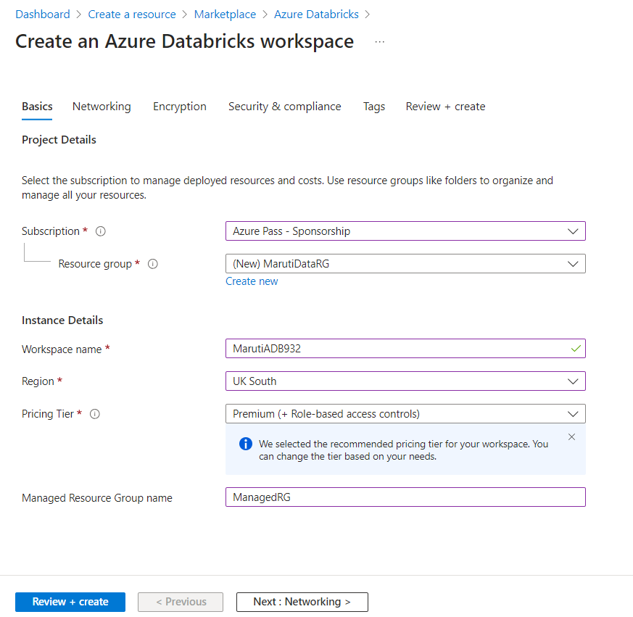

Slide 8
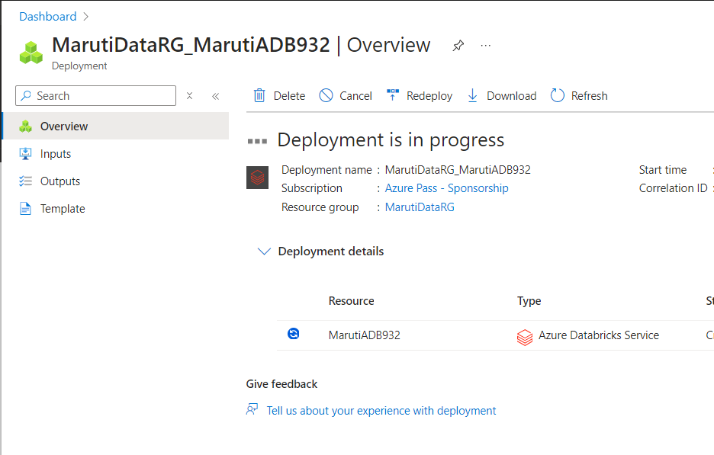

Slide 9
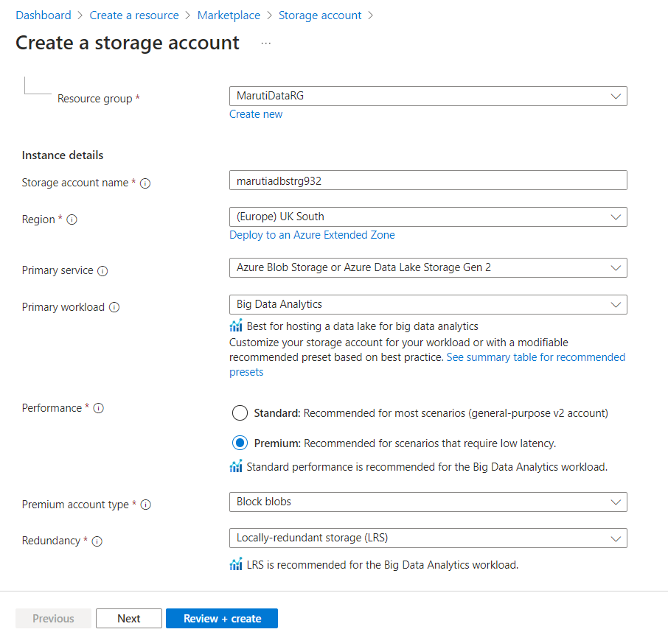

Slide 10
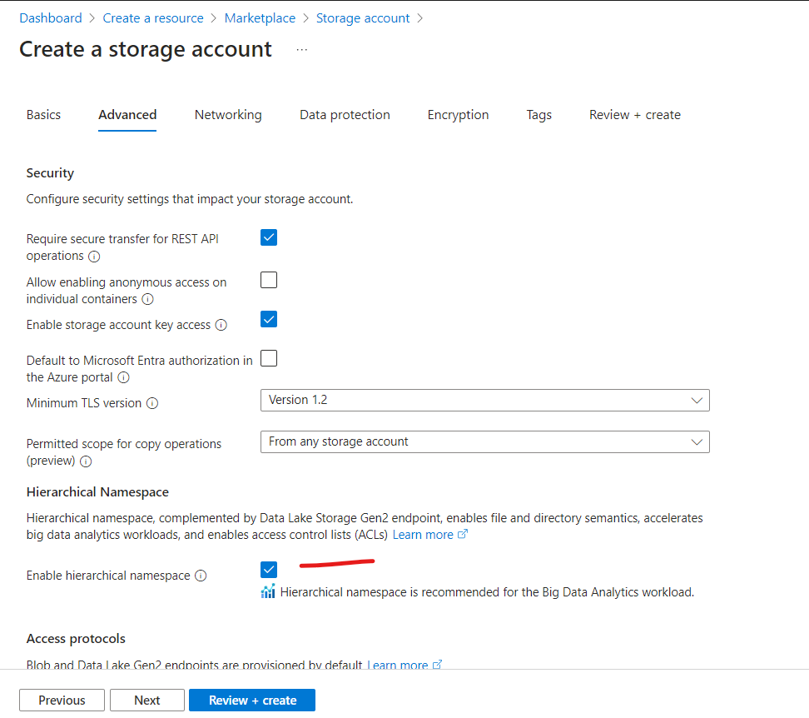

Slide 11
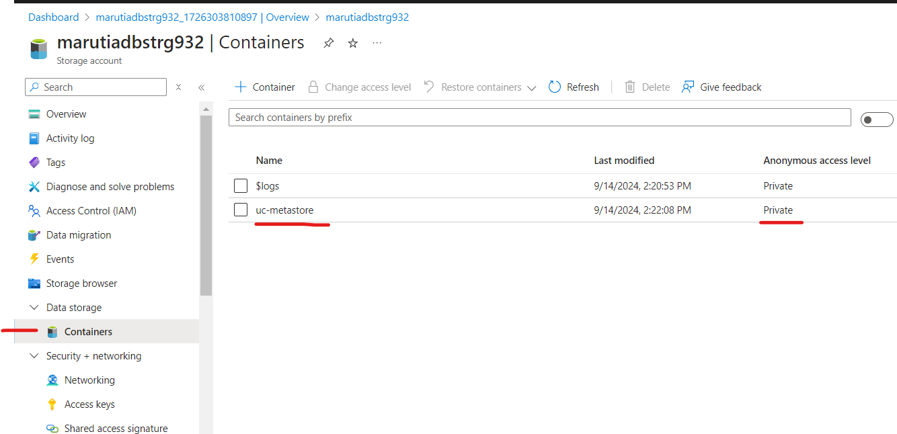
Create new container

Slide 12
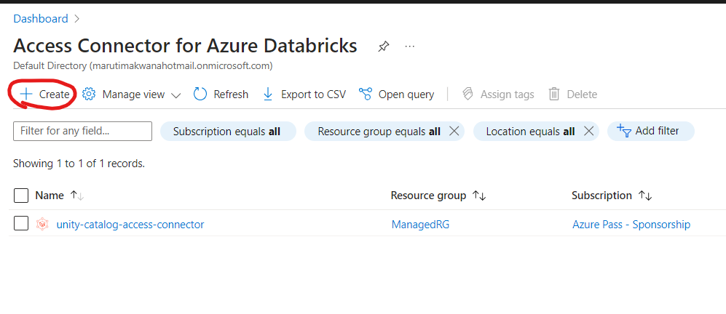

Slide 13
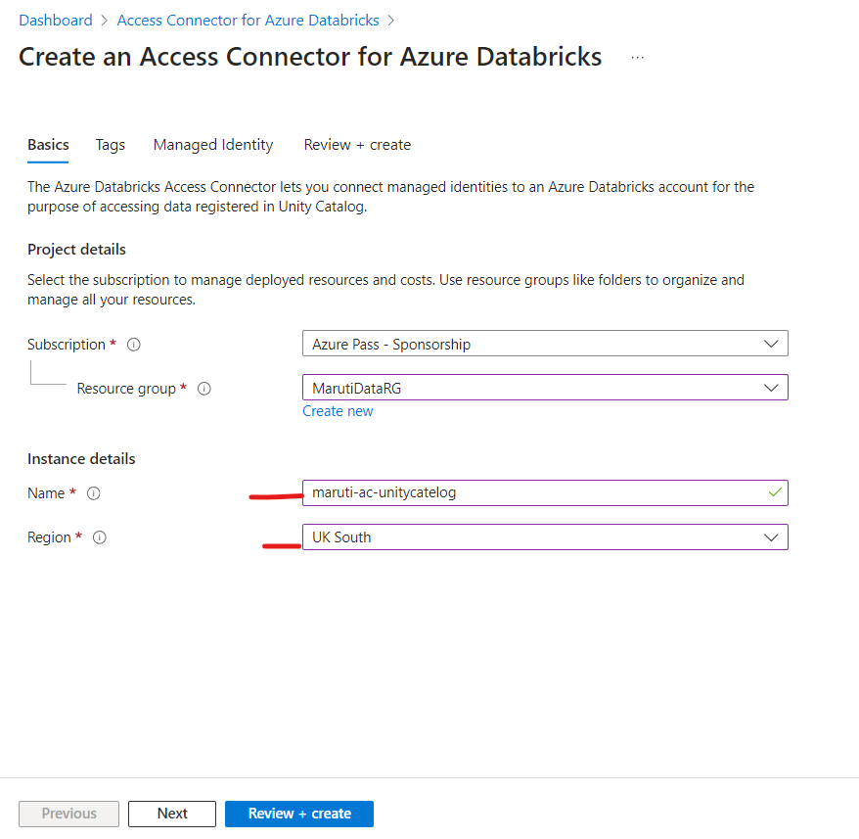

Slide 14
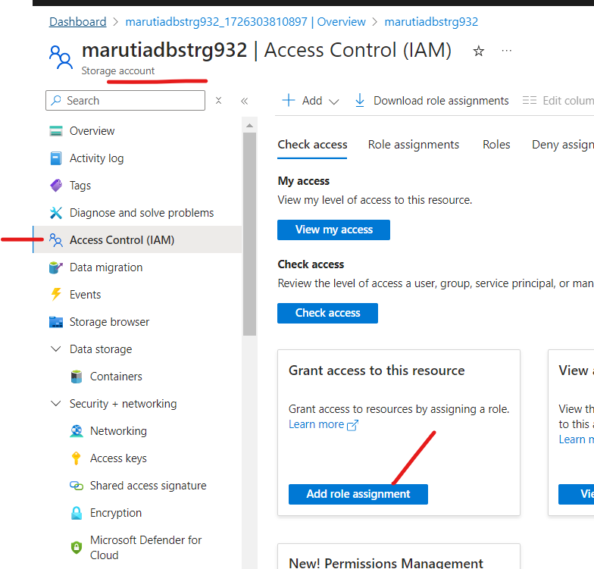

Slide 15
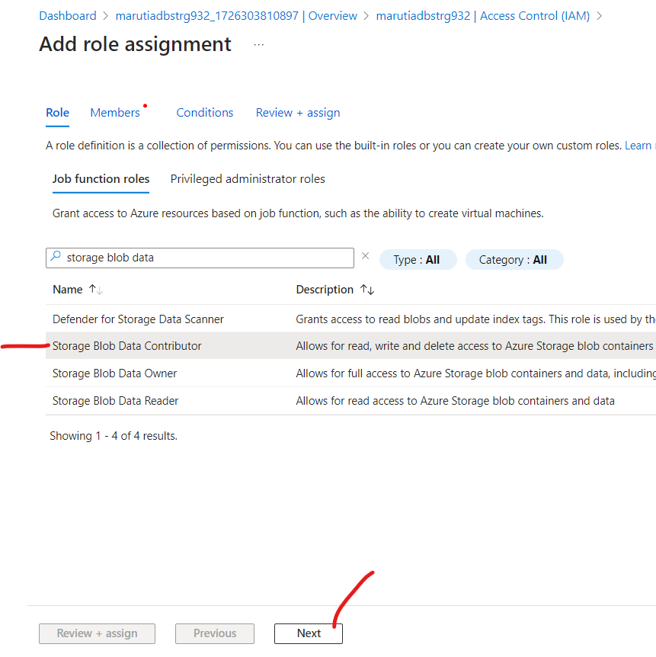

Slide 16
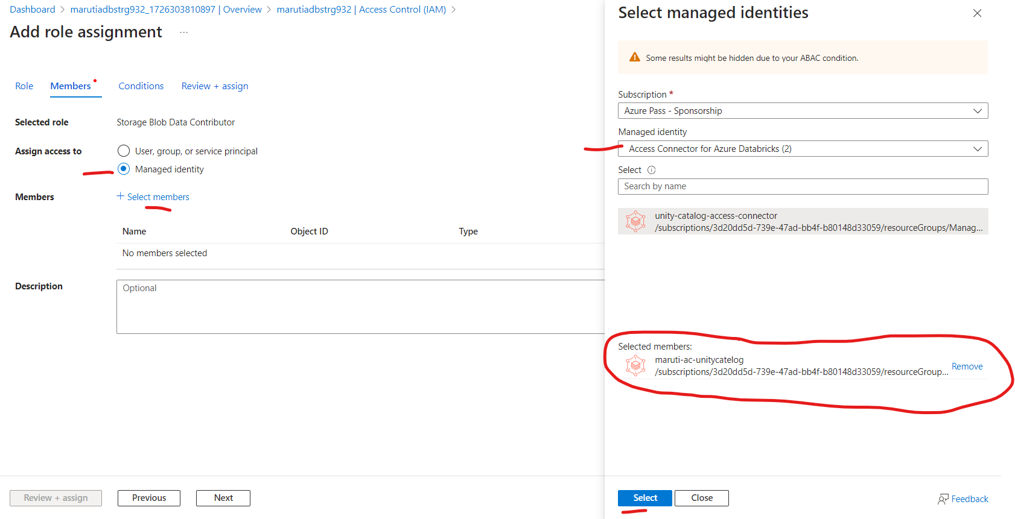

Slide 17
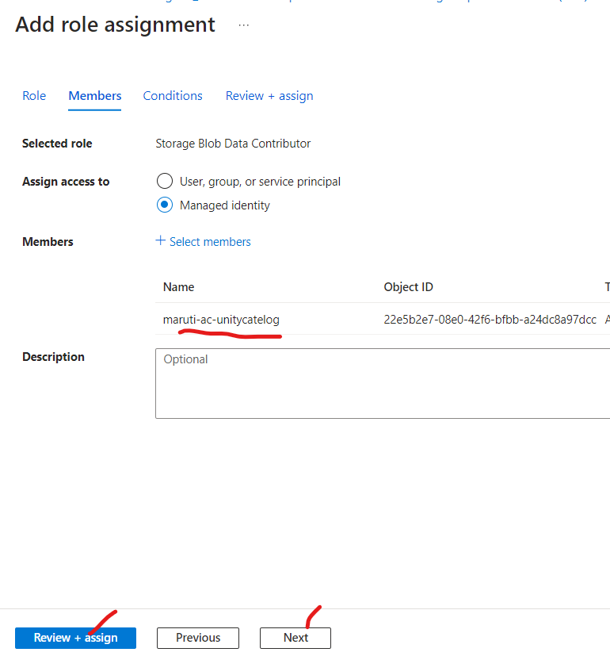

Slide 18
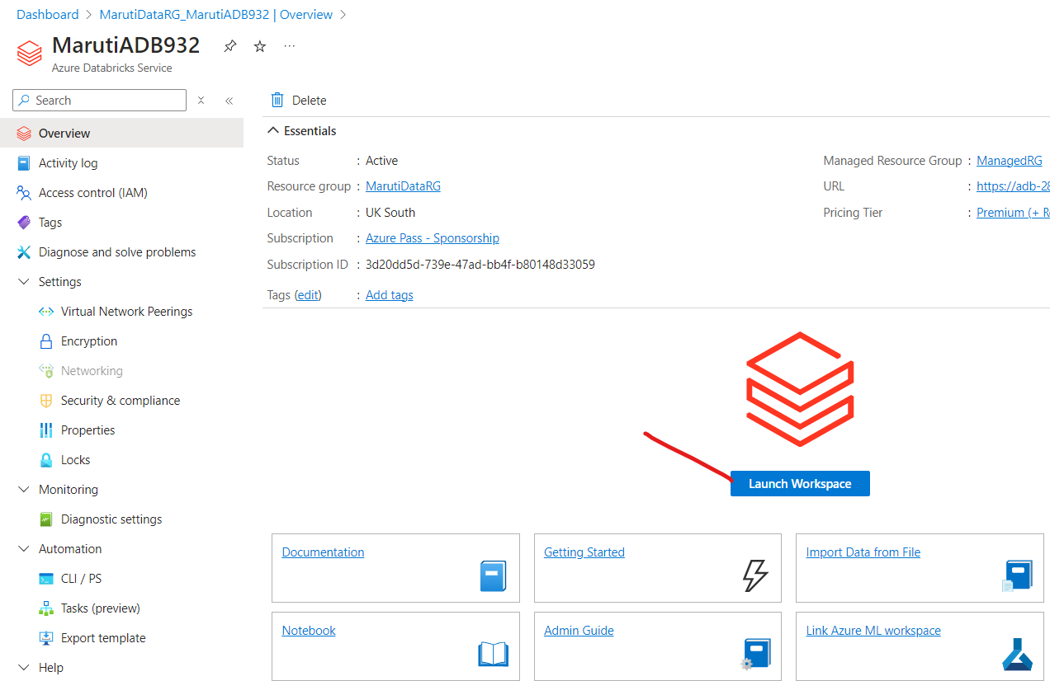

Slide 19
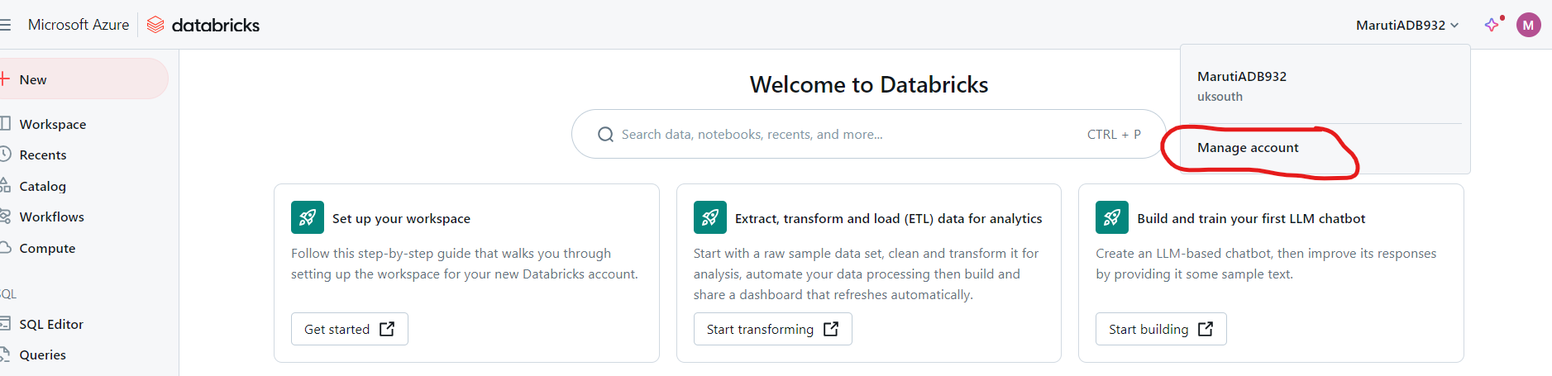
You will be redirected to manage account section only if you are global admin and part of EntraID

Slide 20
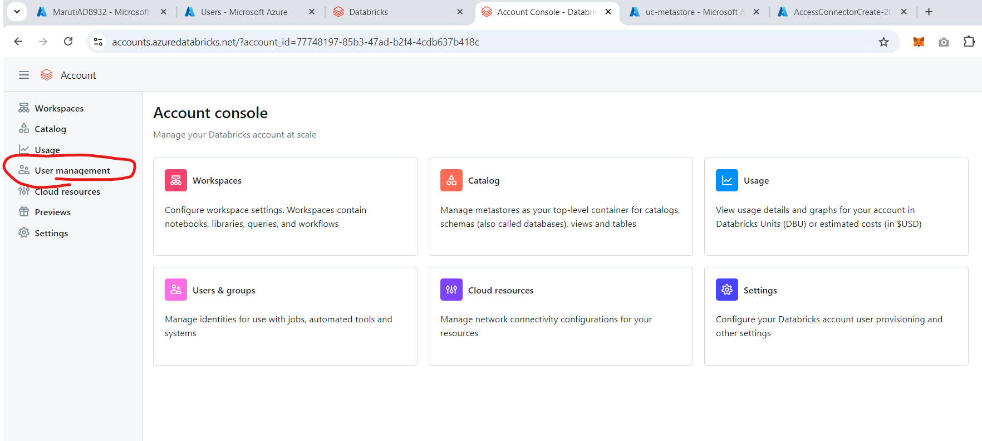

Slide 21
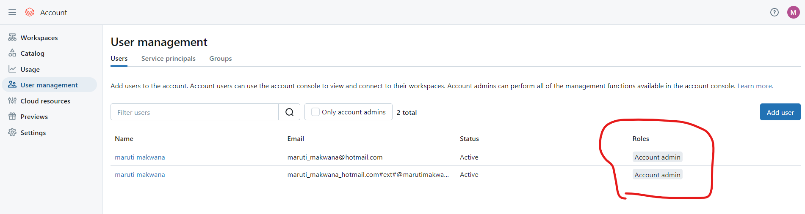
Any user with account admin role can access account console

Slide 22
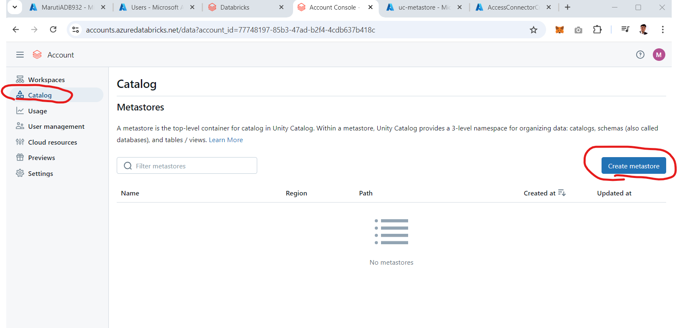

Slide 23
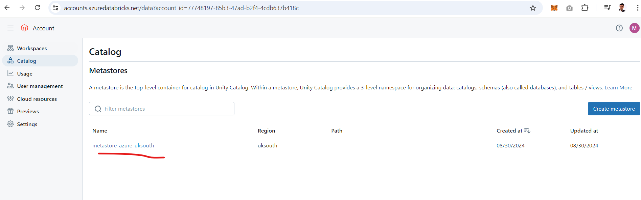
You can use this metastore or delete this and create new one

Slide 24
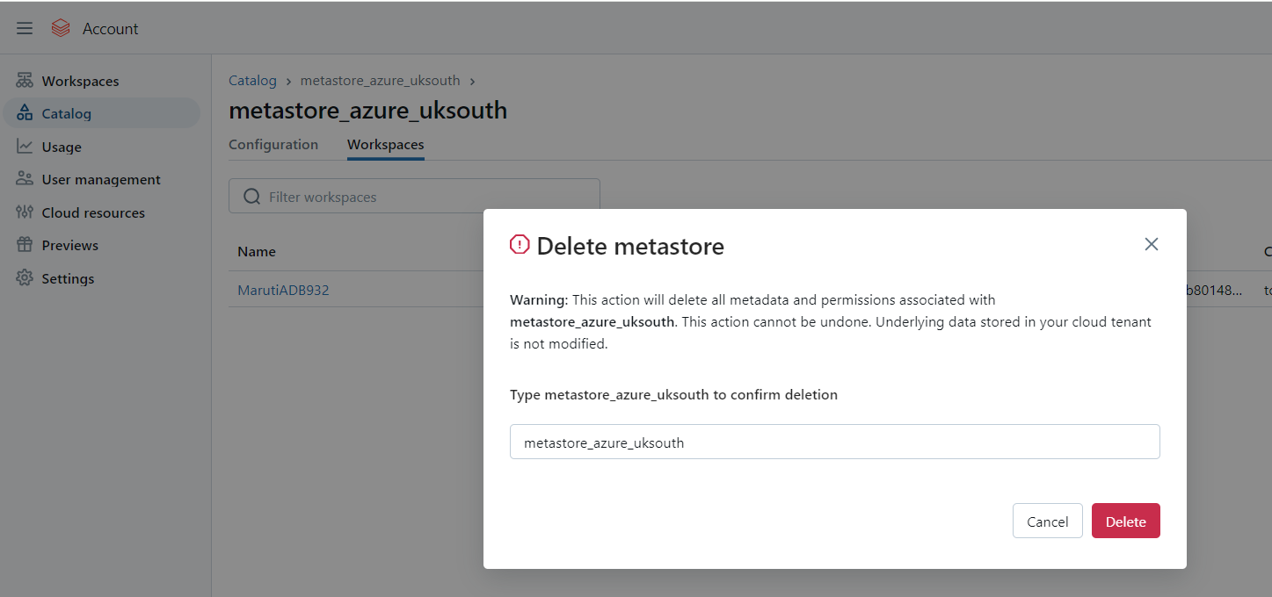

Slide 25
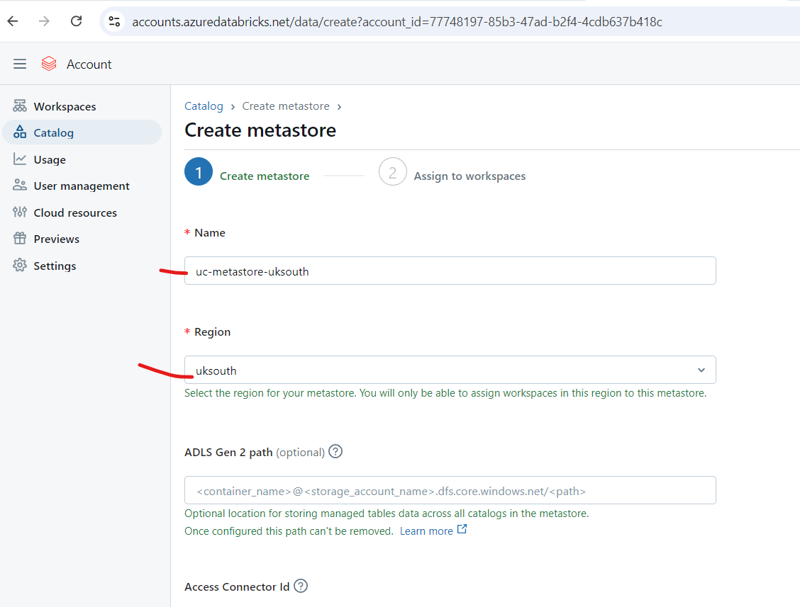

Slide 26
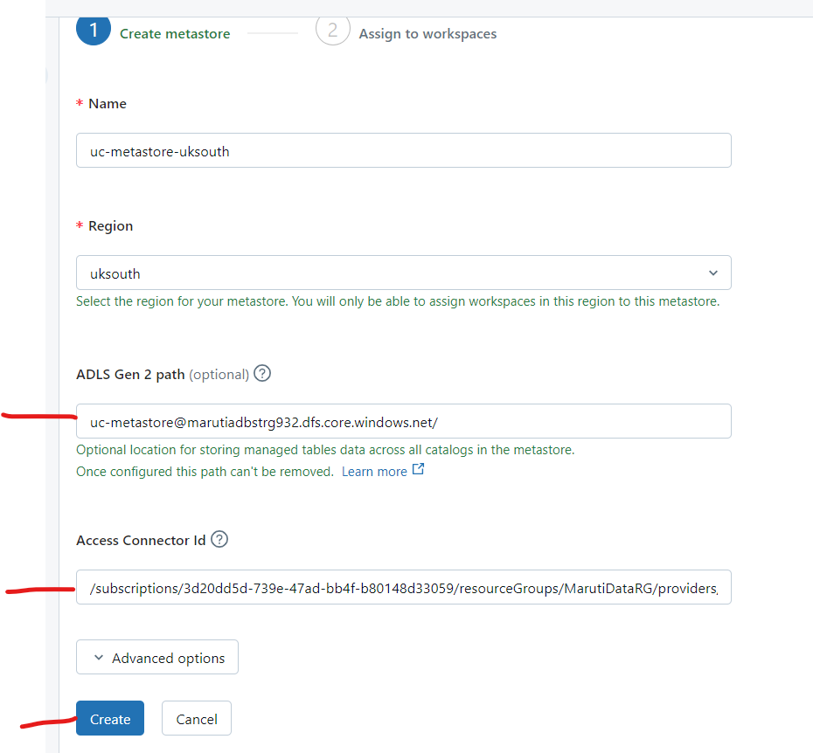

Slide 27
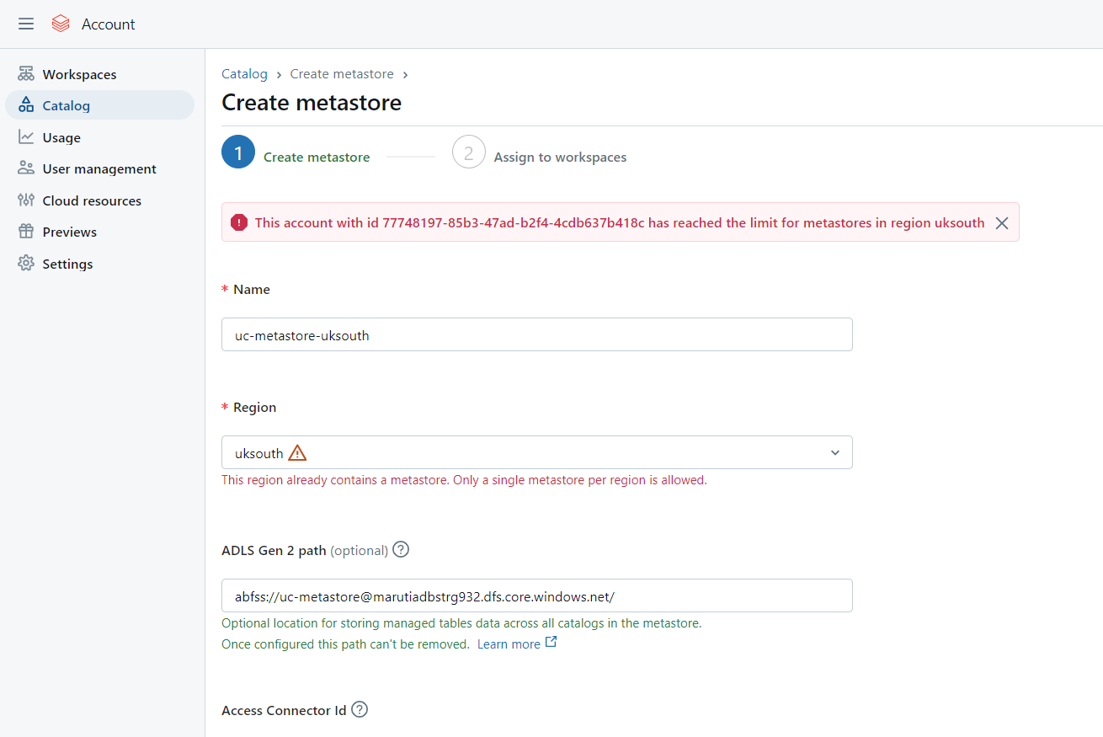

Slide 28
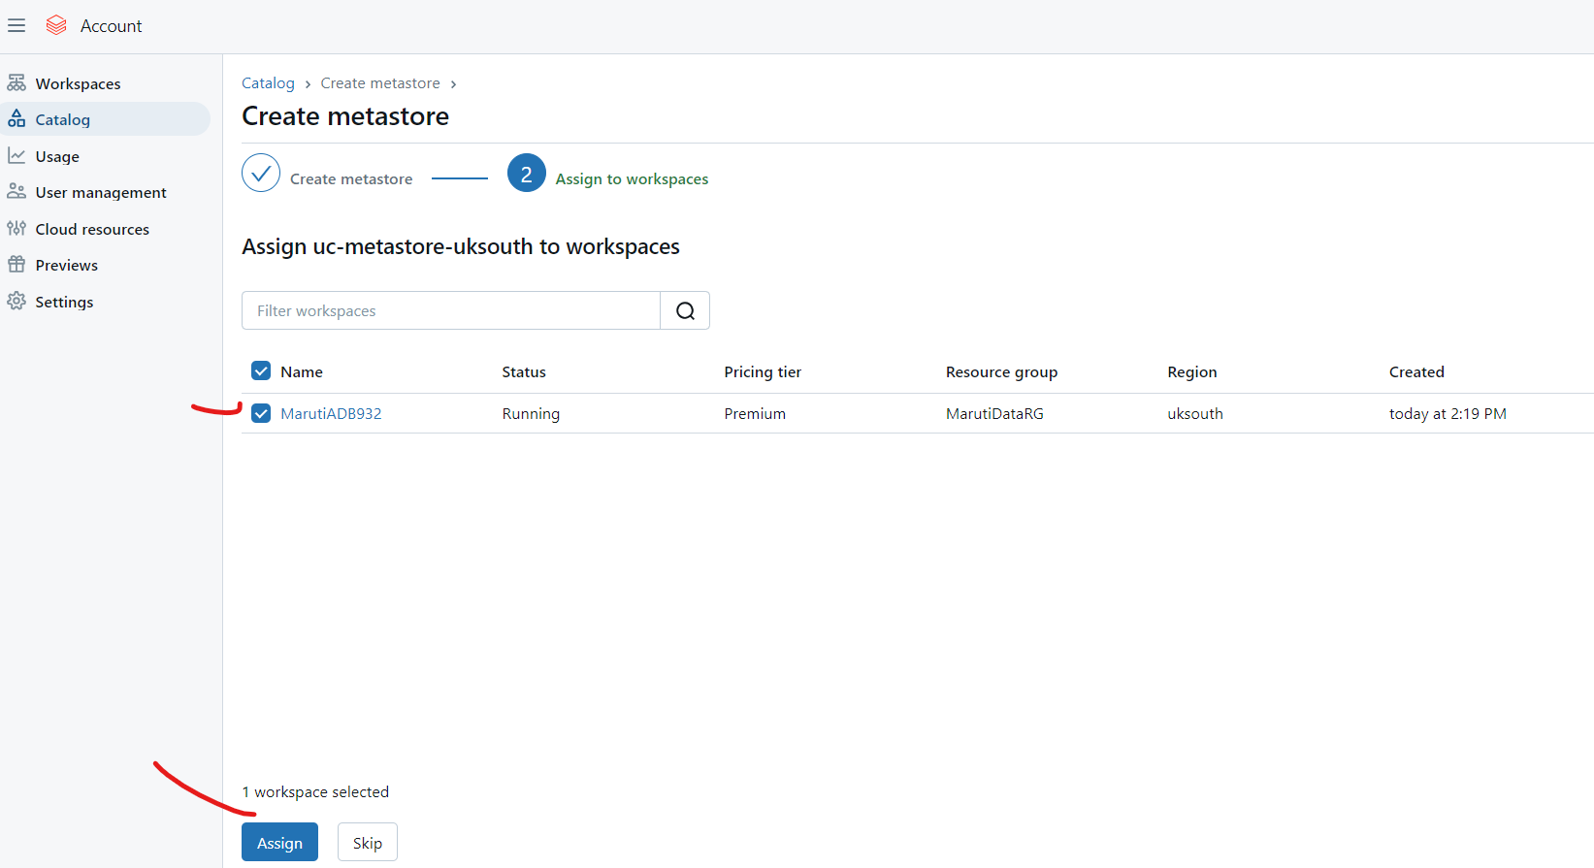
You can select multiple workspaces which belongs to premium tier and same region

Slide 29
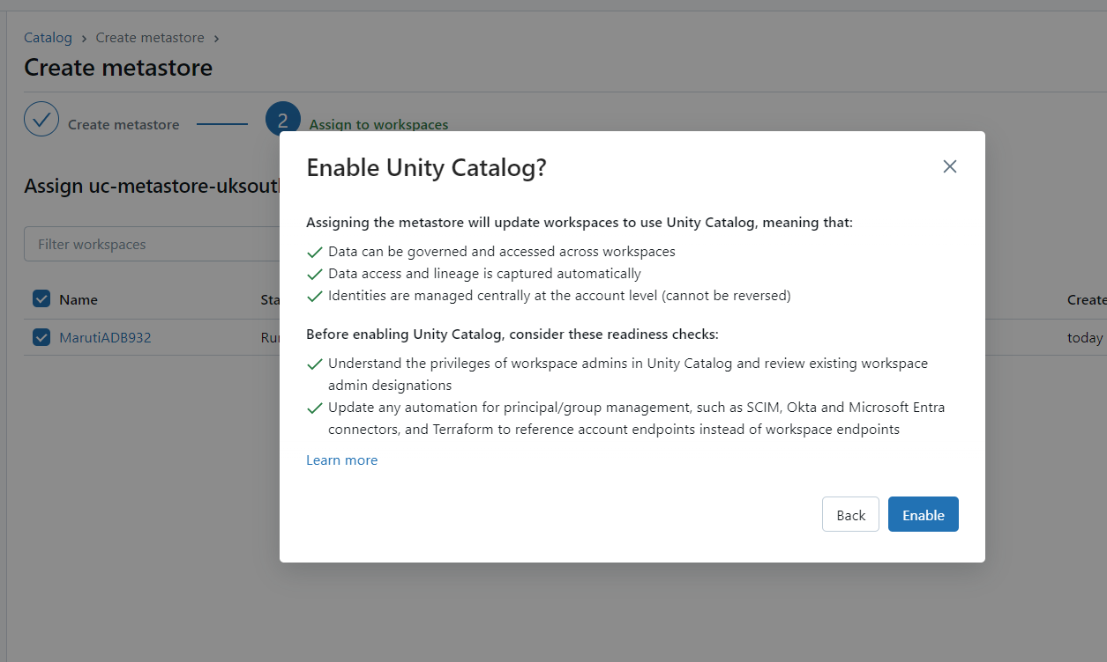

Slide 30
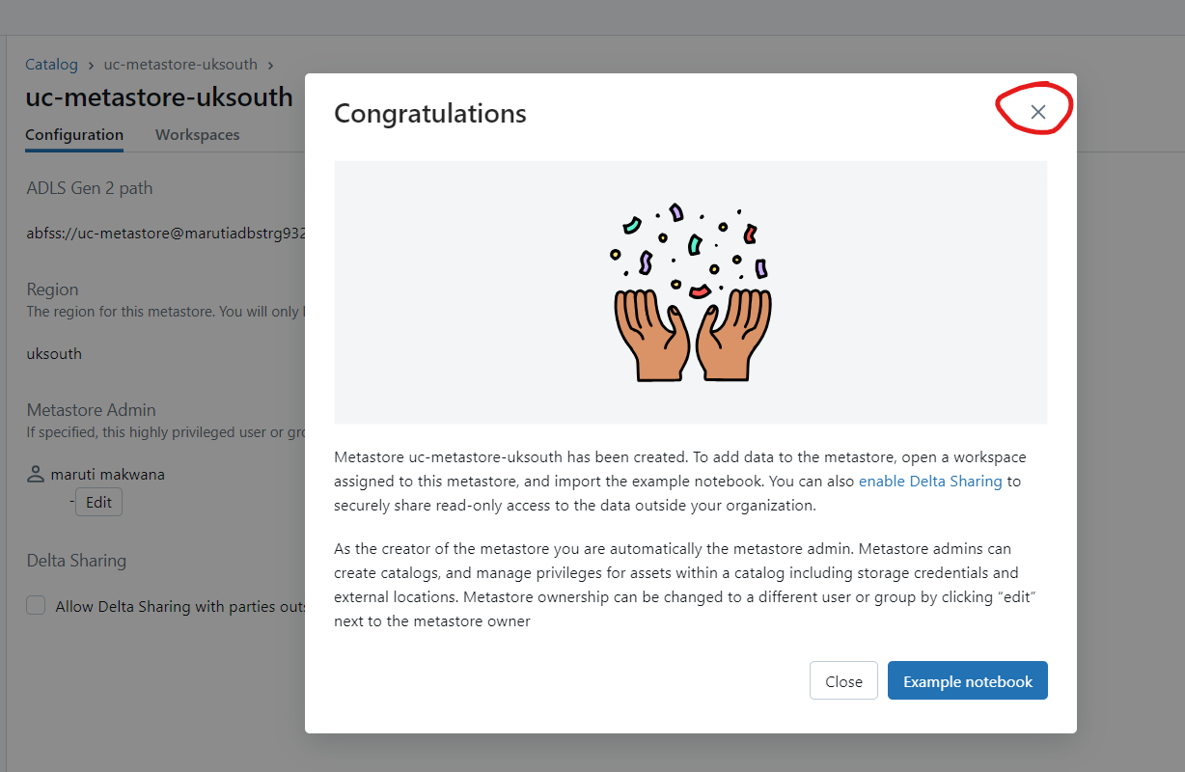

Slide 31
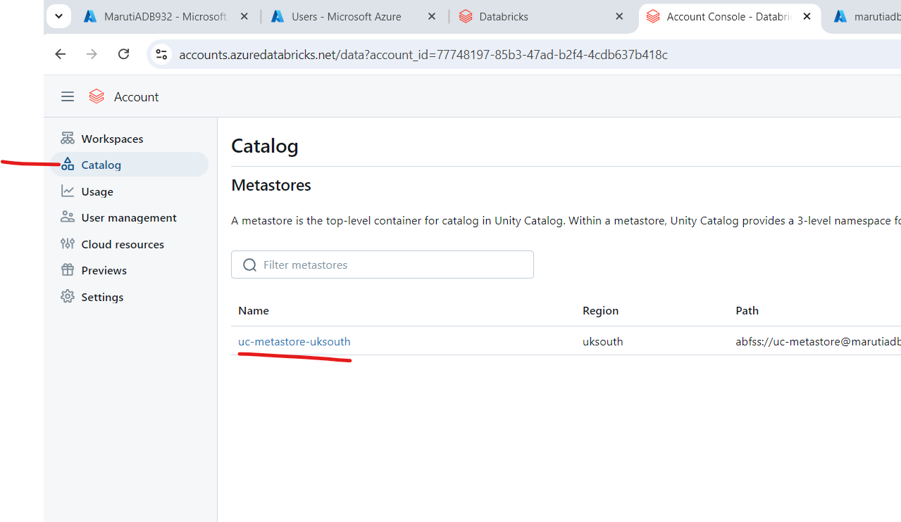

Slide 32
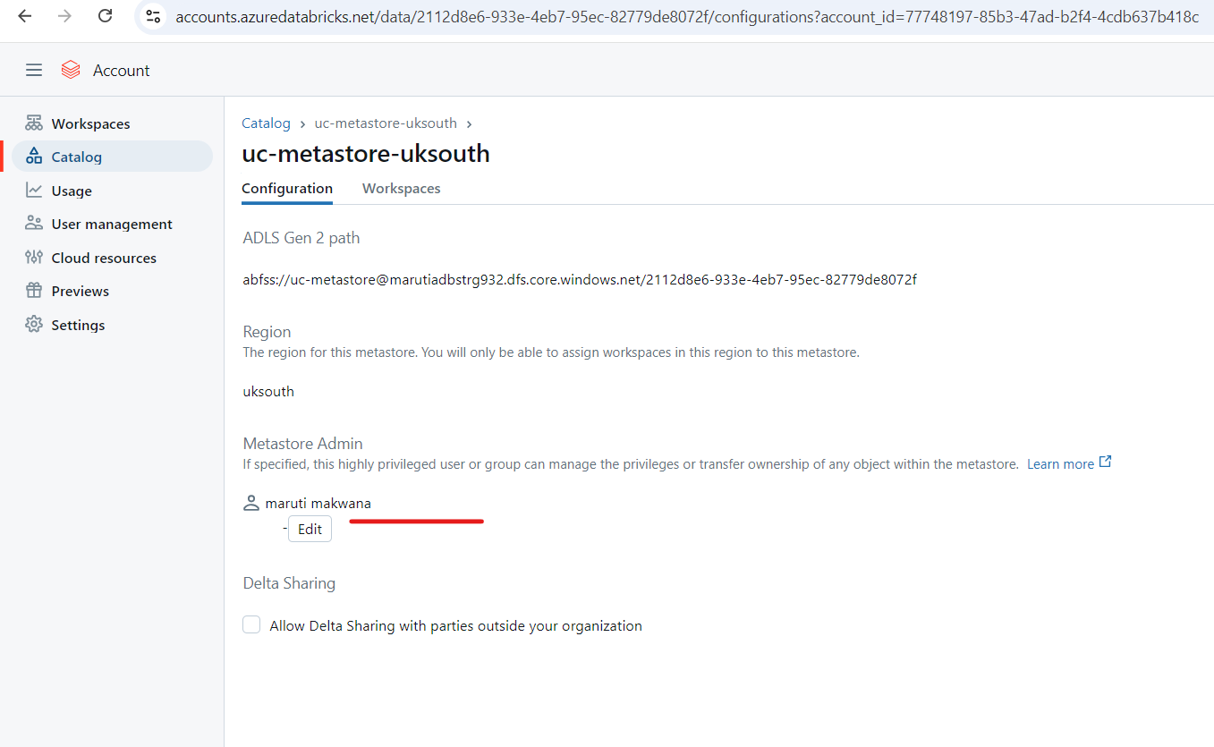
Make your user admin of this metastore
Not EntraID user

Slide 33
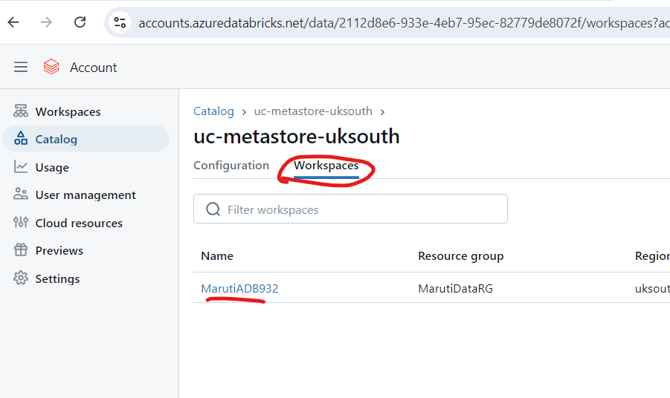

Slide 34
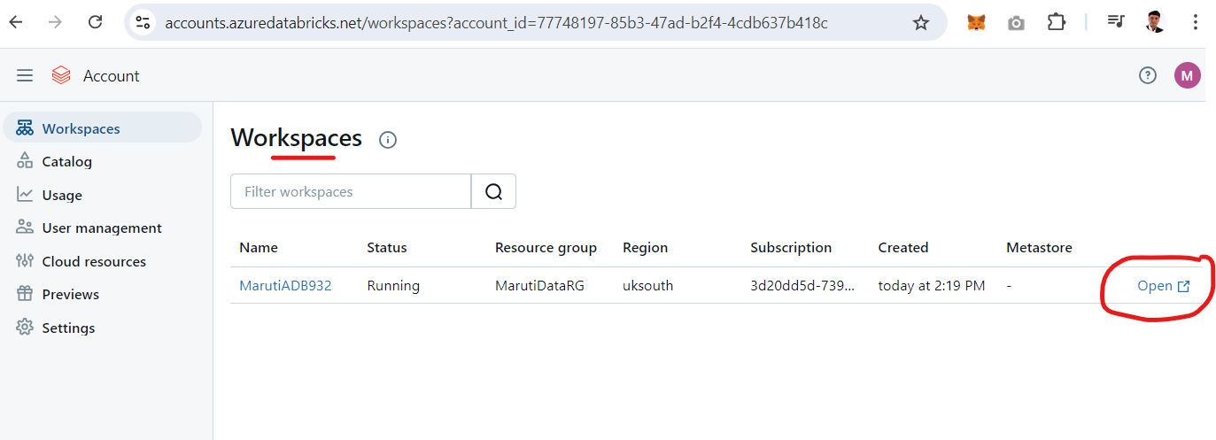

Slide 35
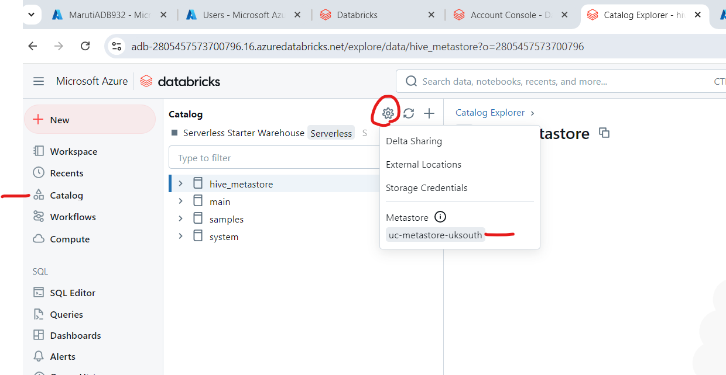
Confirm its showing metastore

Slide 36
Congratulations you have successfully enable unity catalog for your workspace

Slide 37
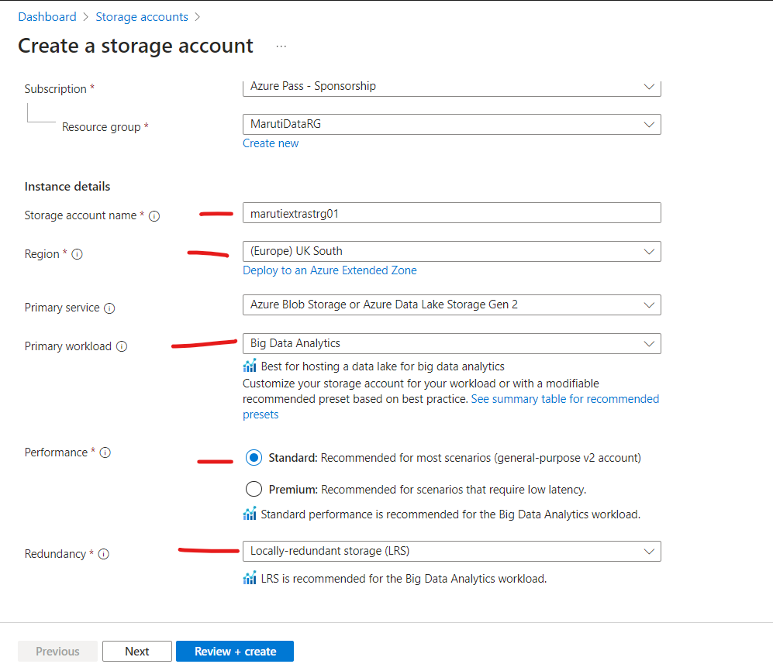

Slide 38
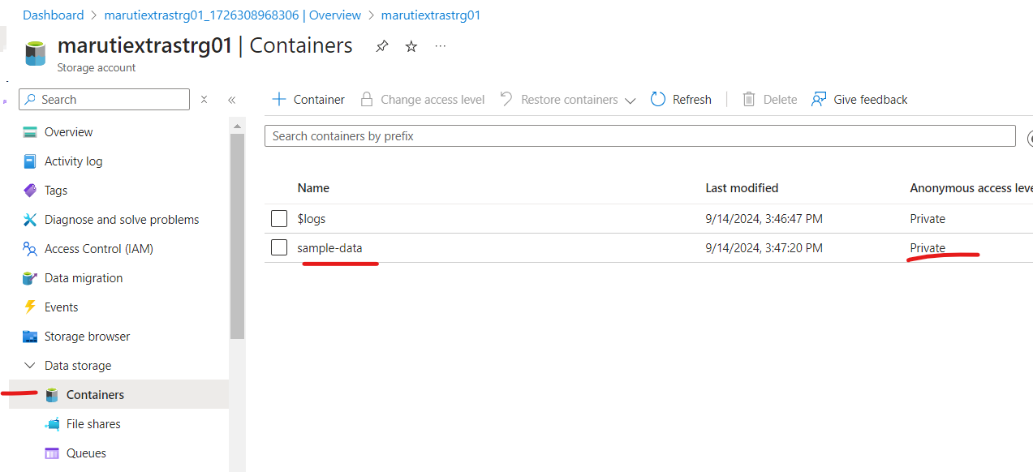

Slide 39
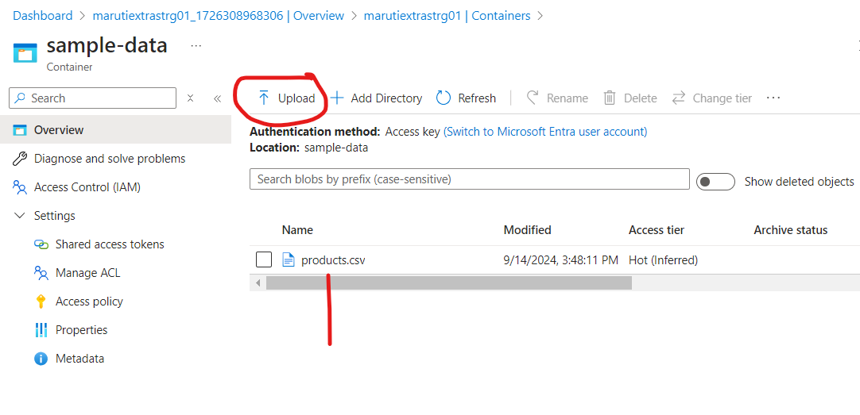

Slide 40
If you want to connect this storage with your ADB with unity catalog enable then…
1 Create Access connector for ADB
2 Grant Storage blob data contributor to Access connector for ADB on storage account
3 Create storage Credentials
4 Create External location

Slide 41
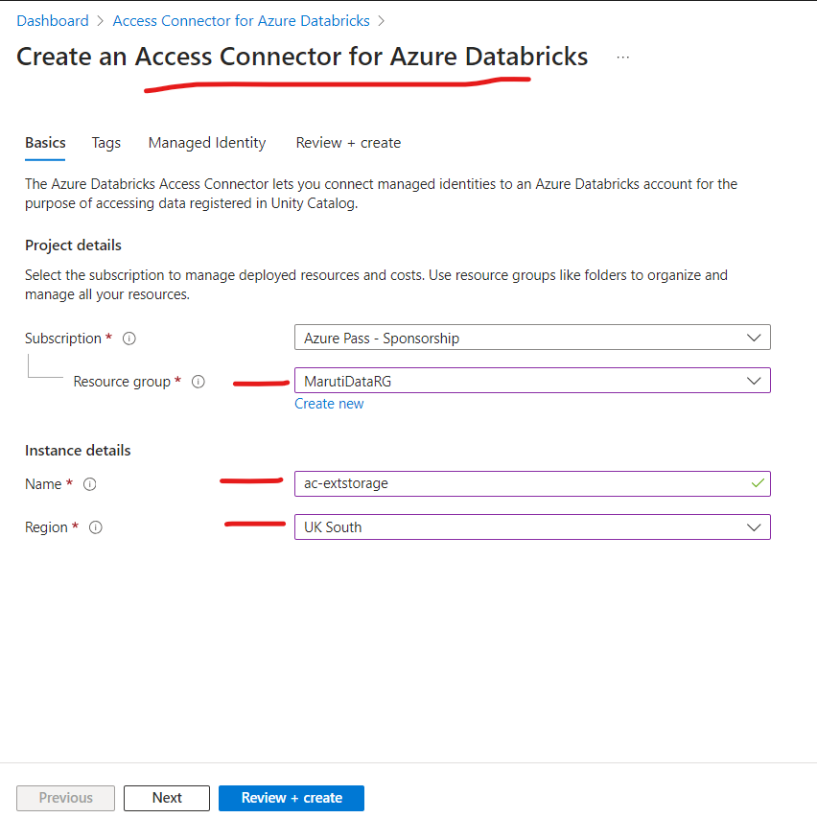

Slide 42
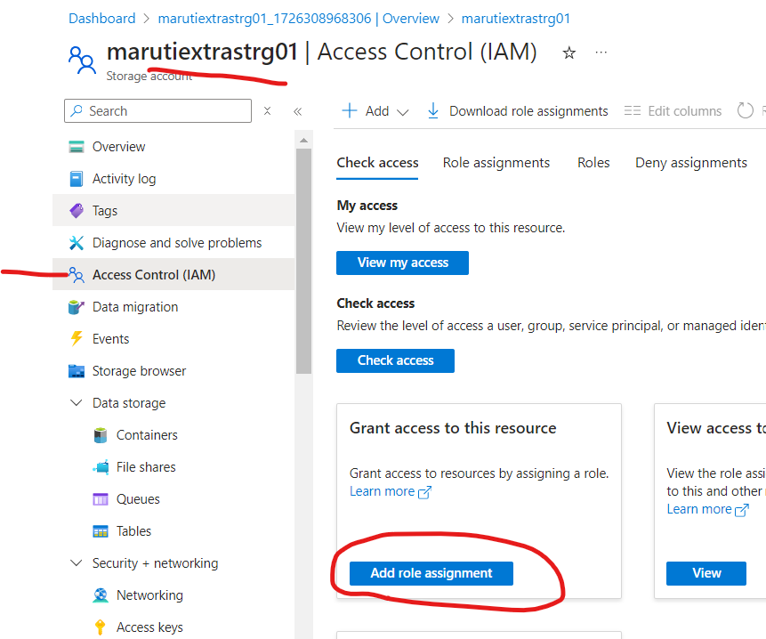

Slide 43
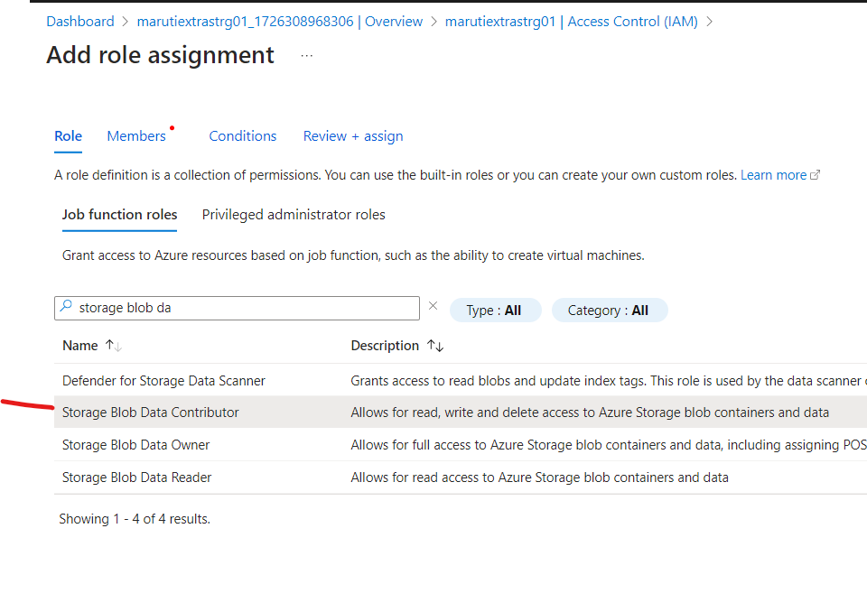

Slide 44
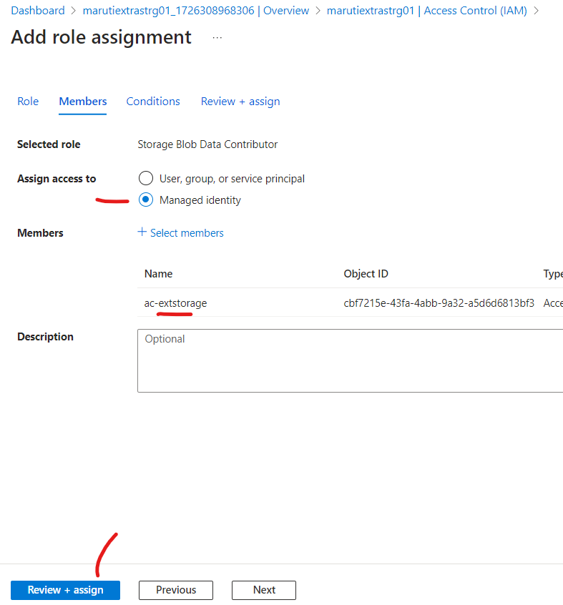

Slide 45
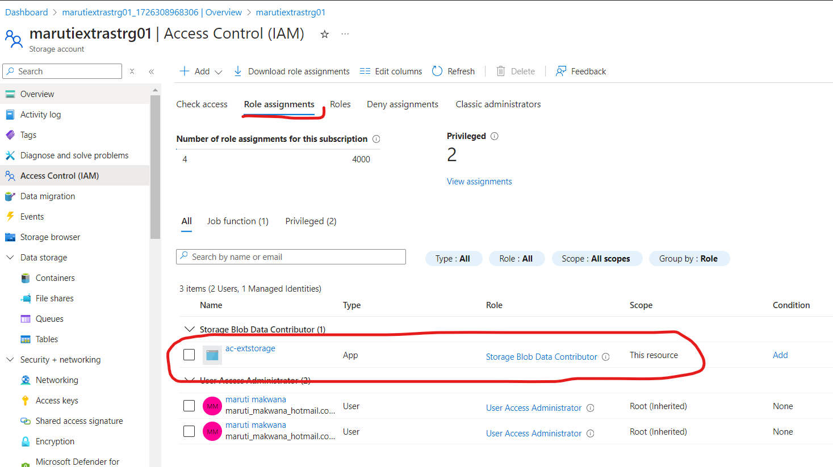

Slide 46
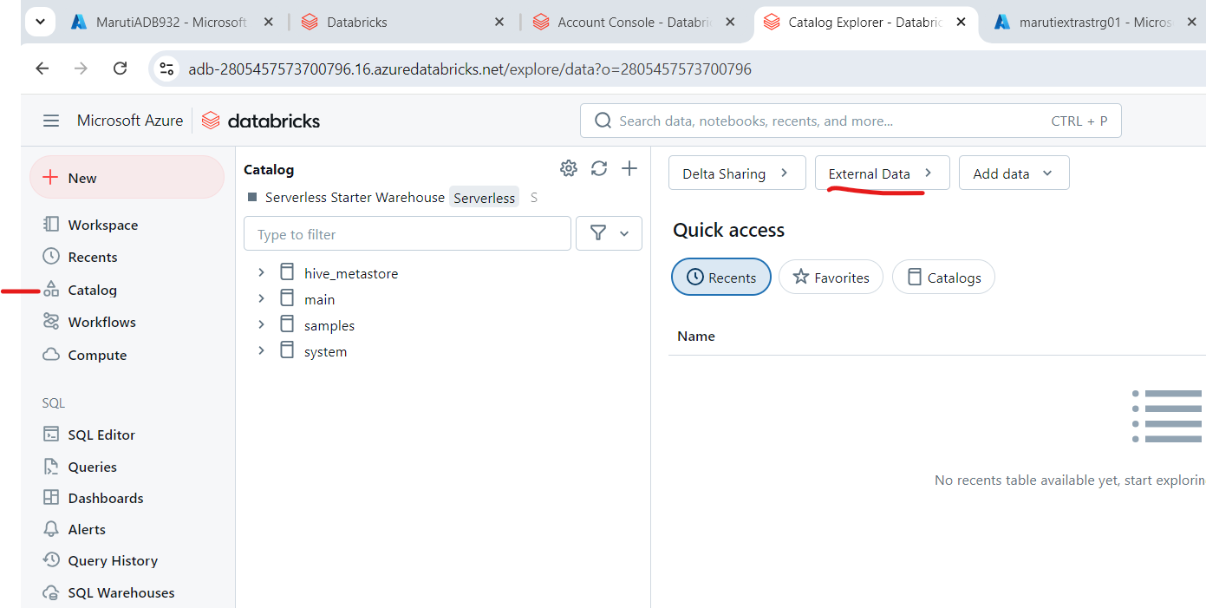

Slide 47
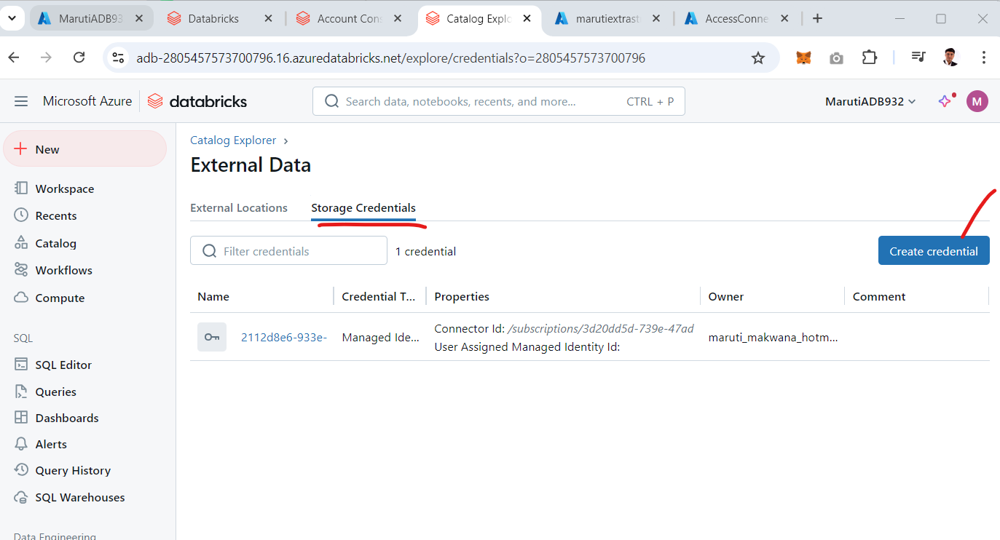

Slide 48
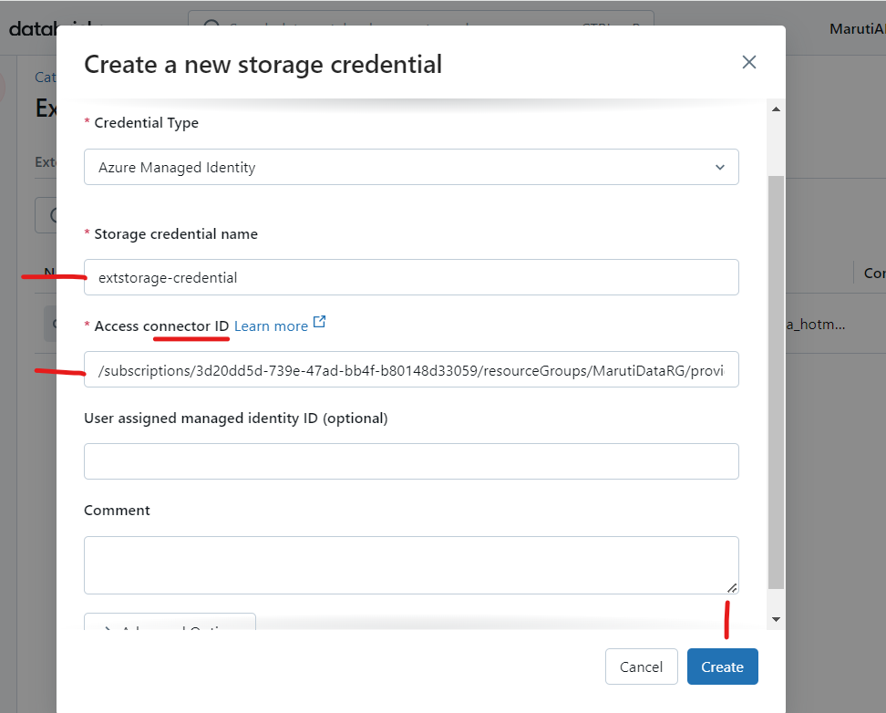

Slide 49
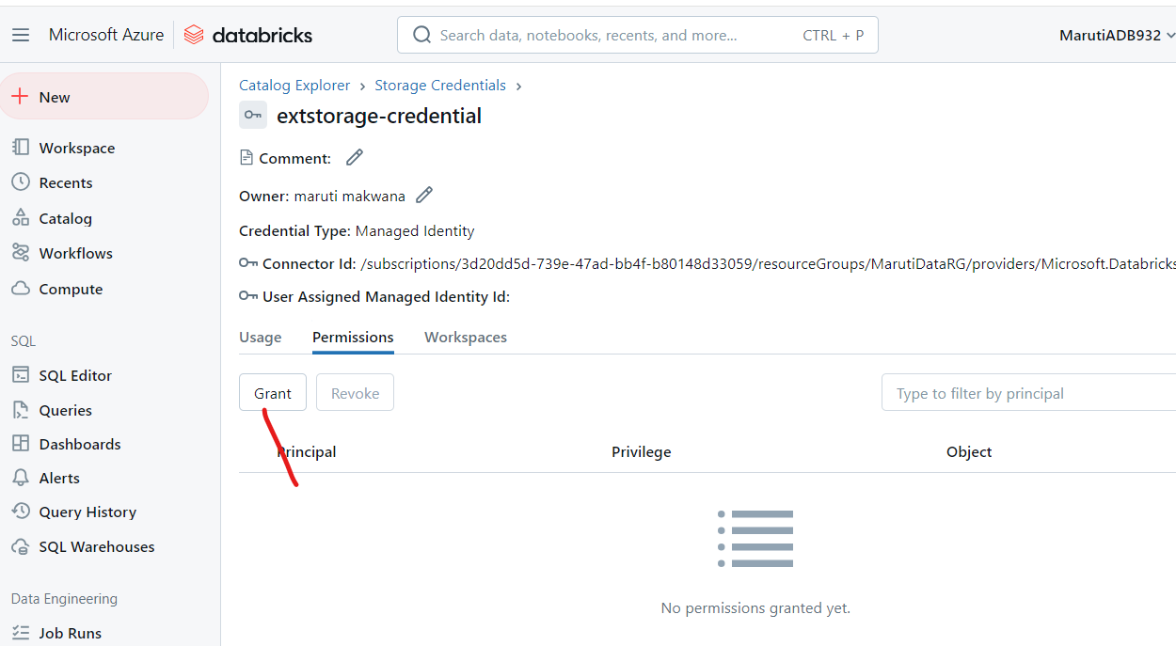
If you want to Grant permissions you can do it by clicking on this

Slide 50
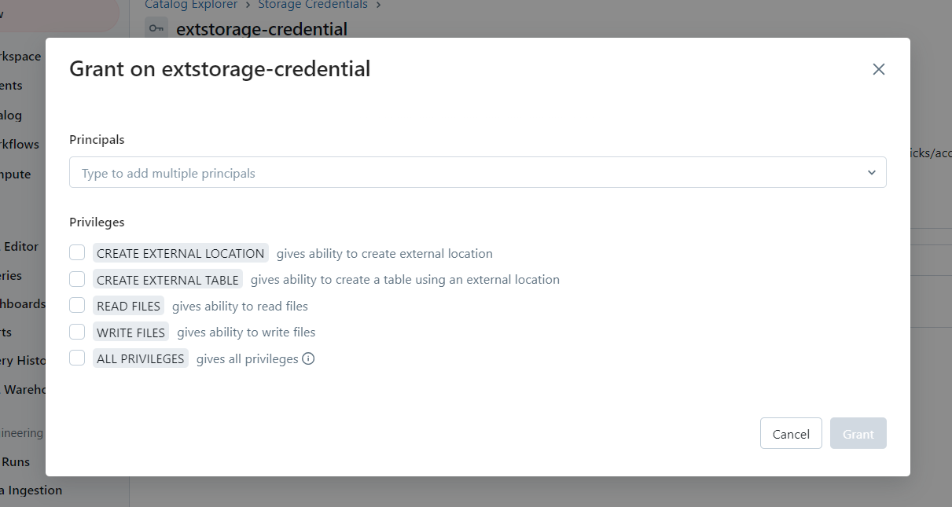
As of now we want to select All privileges

Slide 51
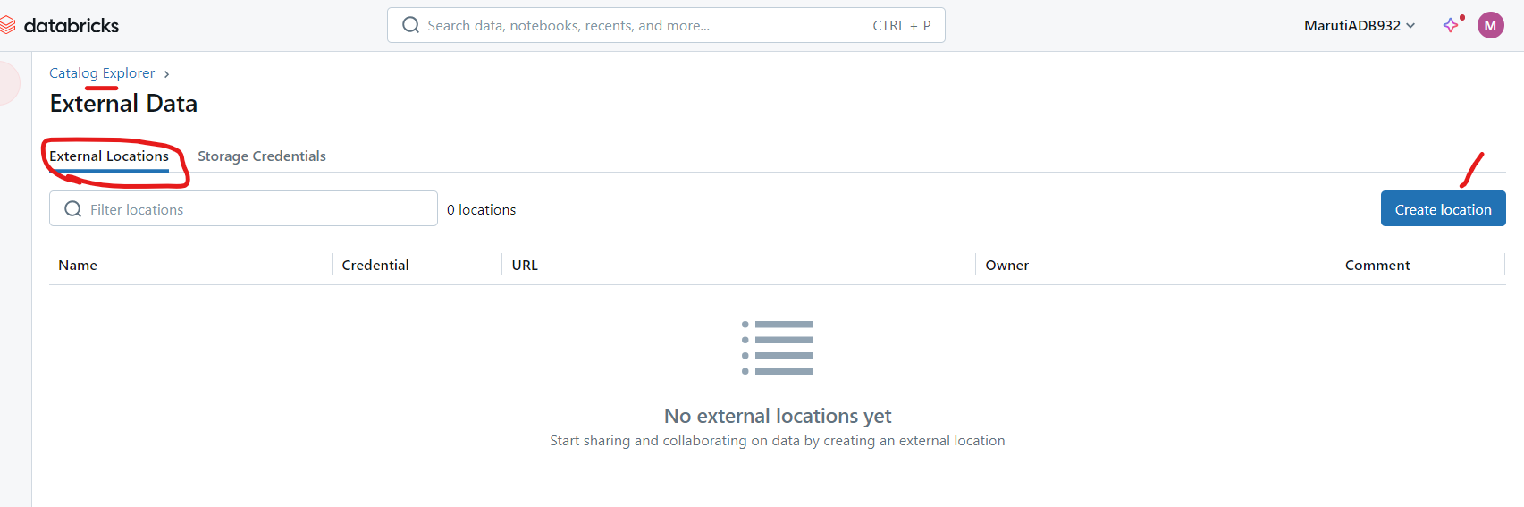

Slide 52
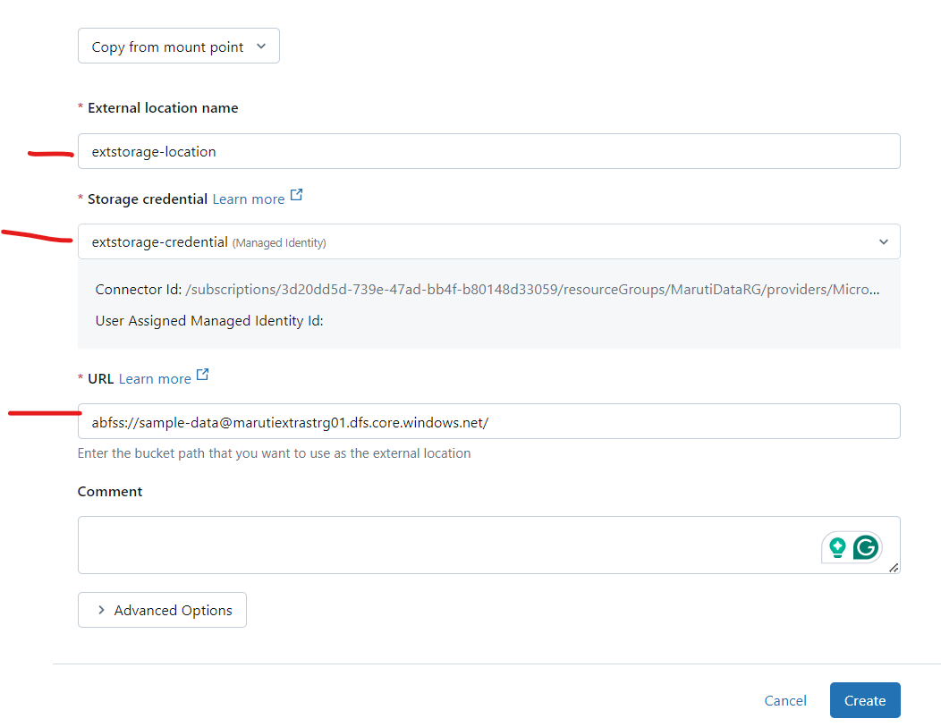
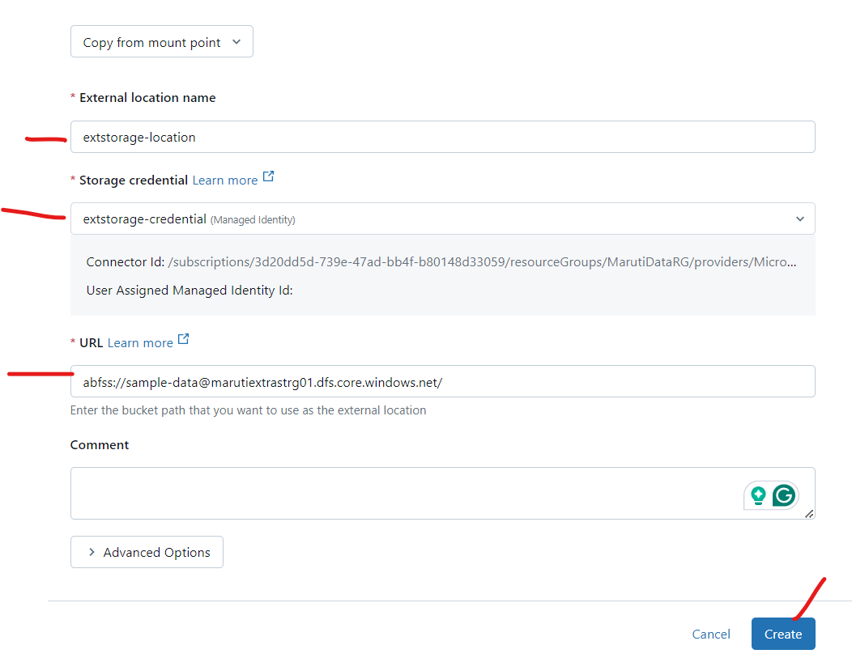

Slide 53
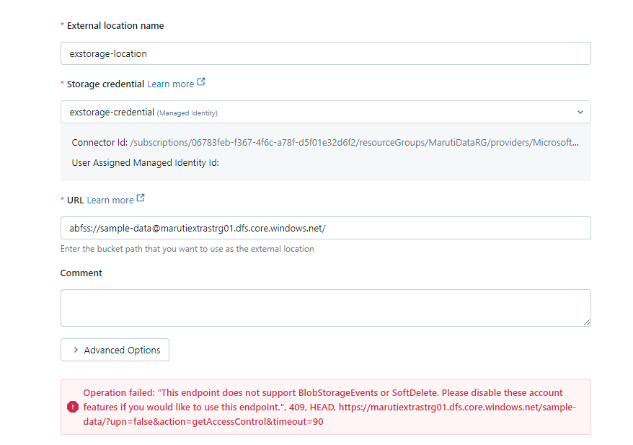

Slide 54
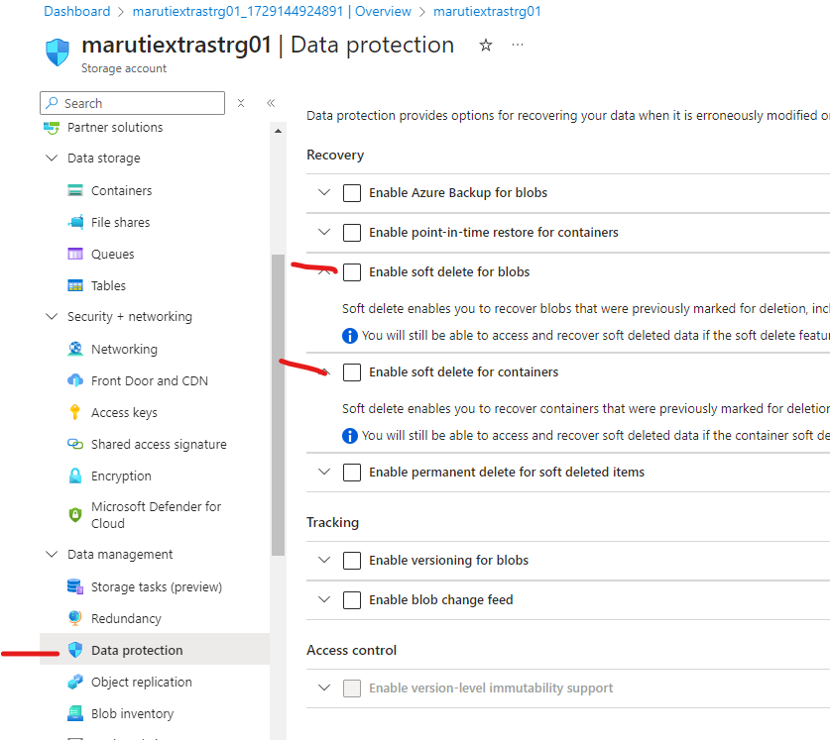

Slide 55
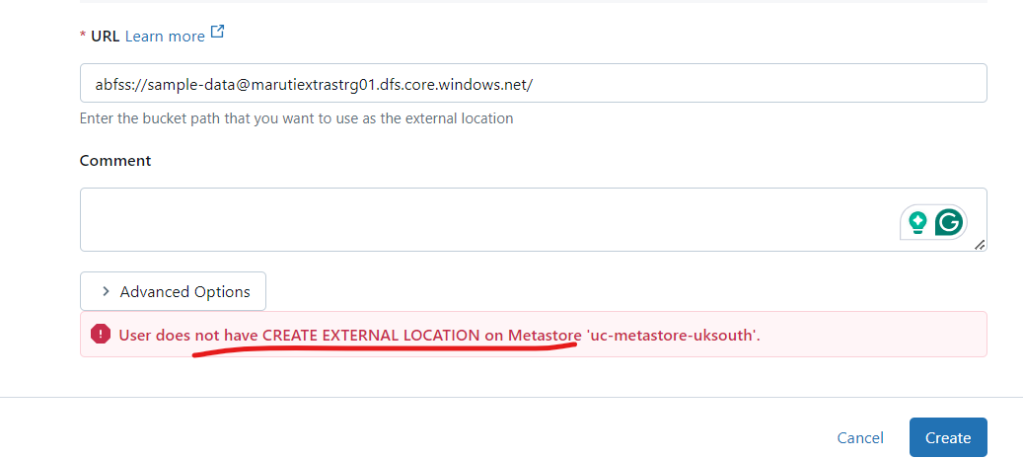
Is this issue is there then it means your meta-store admin is wrong

Slide 56


Slide 57



Slide 58


Slide 59


Slide 60


Slide 61
Now Let’s Explore Catalogs and Schemas

Slide 62


Slide 63


Slide 64


Slide 65


Slide 66



Slide 67



Slide 68

Currently all workspaces have access to this catalog

Slide 69


Slide 70


Slide 71


Slide 72


Slide 73

Now let’s see how to create catalog and schema using SQL syntax
Import Catalogs and Schemas

Slide 74


Slide 75


Slide 76


Slide 77


Slide 78


Slide 79

If I try this it will not work because default is RESTRICT which won’t allow to drop if any object exists inside catalog

Slide 80


Slide 81

With CASCADE it will work

Slide 82



Similarly if you try to delete Demo_catalog using UI it still won’t work because it is also not empty

Slide 83

Managed tables in unity catalog are table where unity catalog manages both metadata the data storage
The default type of table in unity catalog is managed table and while creatin it you have to follow 3 level namespace
Catalogname.schemaname.tablename

Slide 84


Slide 85

It’s a delta file format table

Slide 86

Now le’s create External tables in unity catalog. In this case unity catalog only managed the metadata and the underline data is getting stored in external location.
While creating external table you have to mention format and the location of the external storage where you want to store the data

Slide 87
Implement secret scope using Azure Key Vault from another PPT in this same ADB workspace

Slide 88
https://microsoftlearning.github.io/mslearn-databricks/Instructions/Exercises/DE-06-Implement-data-privacy.html

Slide 89
Implementing Data Privacy and Governance using Unity Catalog with Azure Databricks

Slide 90


Slide 91

https://github.com/MicrosoftLearning/mslearn-databricks/raw/main/data/DE-05/customers.csv
https://github.com/MicrosoftLearning/mslearn-databricks/raw/main/data/DE-05/products.csv
https://github.com/MicrosoftLearning/mslearn-databricks/raw/main/data/DE-05/sales.csv

Slide 92


Slide 93


Slide 94


Slide 95


Slide 96

Upload all 3 files in this

Slide 97


Slide 98


Slide 99



Slide 100
Set up ACLs and dynamic data masking
Access control lists (ACLs) are a fundamental aspect of data security in Azure Databricks, allowing you to configure permissions for various workspace objects.
With the Unity Catalog, you can centralize the governance and auditing of data access, providing a fine-grained security model that is essential for managing data and AI assets.

Slide 101

In a new cell, run the following code to create a secure view of the customers table to restrict access to PII (Personally Identifiable Information) data.

Slide 102


Slide 103


